Slide 1

TEAM GIT_HUB
PROJECT REPORT

Slide 2

TEAM GIT-HUB
01.
ESUONG BASSEY
02.
AKINTADE IBUKUN
03.
FASAKIN MOTUNRAYO
04.
OLUWASEGUN BOLADE
05.
TOSIN FAJINMI
06.
ODUNUGA KEHINDE
07.
ALADE LUCY

Slide 3
CONTENT
1
2
3
Report Description
Application Overview
Testing Objectives
4
5
6
Testing Scope
Metrics
Test Environment and Tools

Slide 4

Report Description
This document explains various activities performed as part of testing the eNaira Speed Wallet application.

Slide 5
Report Description
Product Name | eNaira Speed Wallet
Name of Product (Application URL) | Banking application https://enaira.gov.ng/
Product Description | Banking Application
Project Description | Mission Of Project Conduct testing to verify the finctionality of the application features Ensure what features to shut down Improvement for a better experience Best features
 | Project Type | Testing/ Verification
Project Duration | Start Date | 1/11/2021 | End Date | 5/11/2021

Slide 6

Application Overview
The eNaira Speed Wallet is an application that Central Bank of Nigeria-issued digital currency that provides a unique form of money denominated in Naira

Slide 7
Application Overview
eNaira serves as both a medium of exchange and a store of value, offering payment prospects in retail transactions when compared to cash payment.
Real-time passenger information is received from a “central repository system”, which will be referred to before all transactions are made and confirmed.
There are several modules like registration, data collection, payment, and store of value which are integrated to fulfill the purpose.

Slide 8

Testing Objective

Slide 9

Testing Objective
A functional test was carried out on this application to verify the functionality of the application features.

Slide 10

Test Scope
A functionality verification that needs connectivity to a third party cannot be tested, as the connectivity could not be established

Slide 11
In Scope
Out of Scope
Performance testing was not done for this application
Functionality Testing for the following modules is in the scope of Testing the features.
Sign Up
Sign In
Forget Password
History
Pay
Receive
Help
Account
Items not Tested
All the modules in the scope of testing were all tested

Slide 12

Metrics
A functionality verification that needs connectivity to a third party cannot be tested, as the connectivity could not be established

Slide 13
Status Distribution module (ANDROID)
a) Number of test cases planned vs executed
b) Number of Test cases Passed vs Test Failed
 | SIGN UP | SIGN IN | FORGOT PASSWORD | PAY | HISTORY | RECEIVE | HELP | ACCOUNT | TOTAL
Passed
Failed
Not Executed
TOTAL

Slide 14
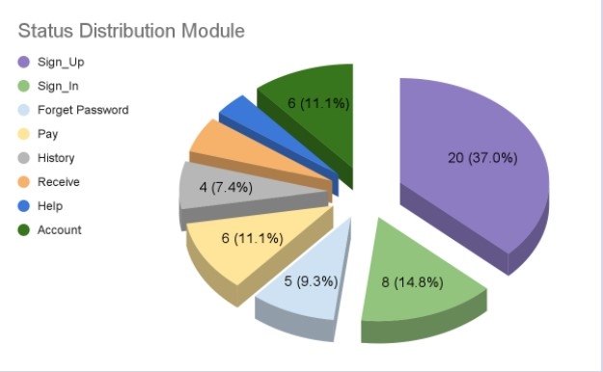

Slide 15
Status Distribution module (iOS)
a) Number of test cases planned vs executed
b) Number of Test cases Passed vs Test Failed
 | SIGN UP | SIGN IN | FORGOT PASSWORD | PAY | HISTORY | RECEIVE | HELP | ACCOUNT | TOTAL
Passed
Failed
Not Executed
TOTAL

Slide 17

Testing Environment and Tools

Slide 18
Status Distribution module (iOS)
Application Name | eNaira Speed Wallet
Application URL | https://enaira.gov.ng/
Platform | Android, iOS
Platform Version | Android 11 XOS 7.6; iOS15.0.2, iOS 14.8.1

Slide 19

Thank you

